Slide 1
SHELTON PERCUSSION

Slide 2
NORWALK PERCUSSION

Slide 3
NAUGATUCK PERCUSSION

Slide 4
DARTMOUTH PERCUSSION

Slide 5
FRANCIS T. MALONEY PERCUSSION

Slide 6
TRUMBULL PERCUSSION

Slide 7
KING PHILIP WINTER PERCUSSION

Slide 8
NEW MILFORD PERCUSSION

Slide 9
CHESHIRE HIGH SCHOOL WINTER PERCUSSION

Slide 10
NEWTOWN INDOOR PERCUSSION

Slide 11
BLACKSTONE-MILLVILLE REGIONAL HIGH SCHOOL INDOOR PERCUSSION

Slide 12
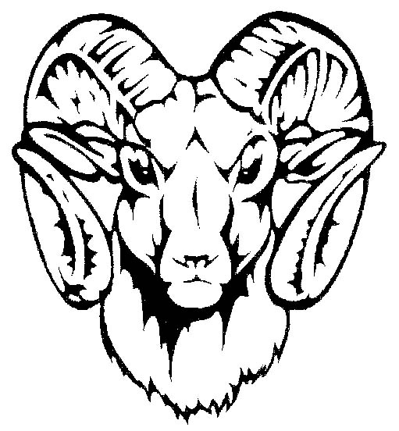
PORT CHESTER WINTER PERCUSSION

Slide 13
MILFORD UNITED PERCUSSION

Slide 14
BUNNELL-STRATFORD HIGH SCHOOL PERCUSSION

Slide 15
RAMSEY HIGH SCHOOL PERCUSSION

Slide 16
MASUK WINTER PERCUSSION

Slide 17
BRIEN MCMAHON GUARD

Slide 18
EAST MEADOW HIGH SCHOOL GUARD

Slide 19
PLAINFIELD PERCUSSION

Slide 20
STAMFORD HIGH SCHOOL BLACK KNIGHTS

Slide 21
ARLINGTON HIGH PERCUSSION

