Slide 1
Public Relations (Competitions, Bingo, Tag Sale, etc.)
WHSBPA

Slide 2
Public Relations
Stamford Patch – Update via webpage
Stamford Advocate – Update via SpinGo
News12 – Update via webpage
Westhill Web – Update via administrator
Westhill PTO News Blast – Update via PTO
Mayor’s Office
It’s Relevant – NA (used to contact editor)

Slide 3
Preparation
Best to have flyer ready outlining:
Date/Time
Event Name & Description
Admission
Contact name, phone, e-mail
Webpage (if applicable)
Pictures (if applicable)
Only Stamford Patch requires credentials:
Email address: houtzdf@yahoo.com
Password: newsrelease

Slide 4
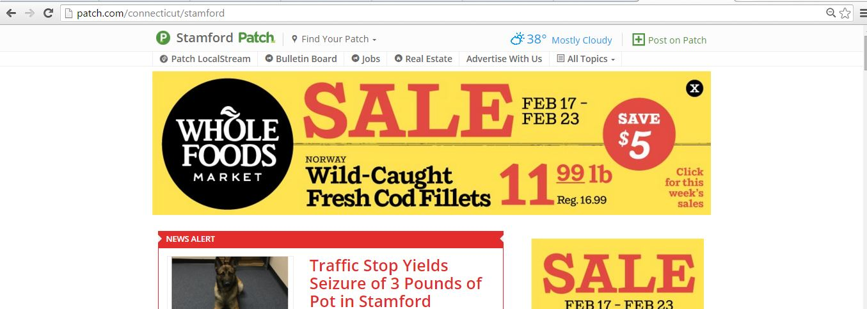
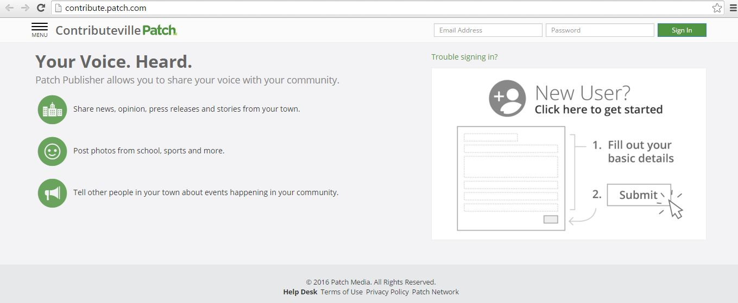
Stamford Patch
Log into webpage
Select Post to Patch
Enter credentials
Select ‘+’ to create new entry/ies. Can view old entries as examples.
Add/modify/delete on your own via webpage.

Slide 5
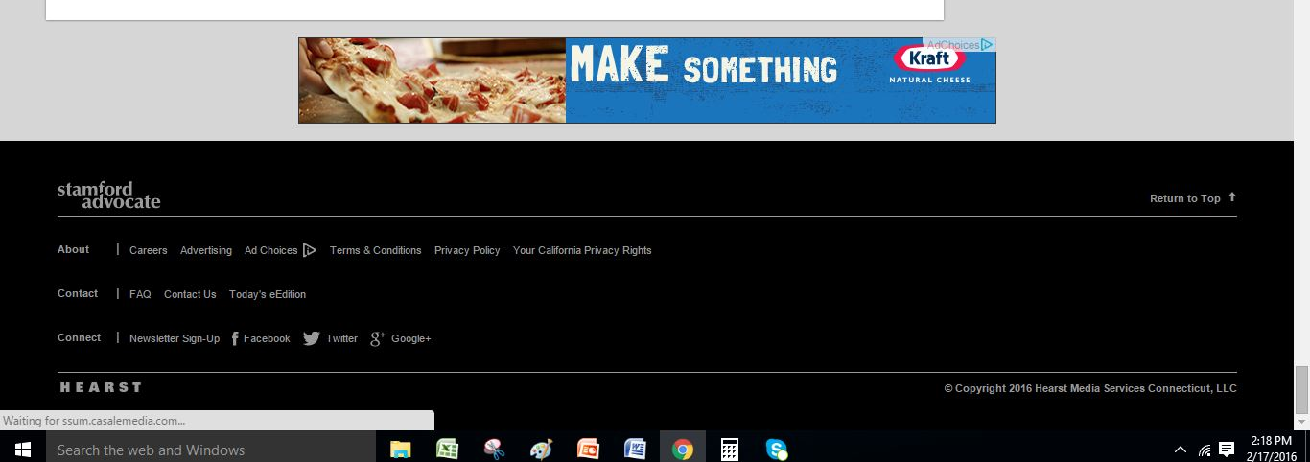
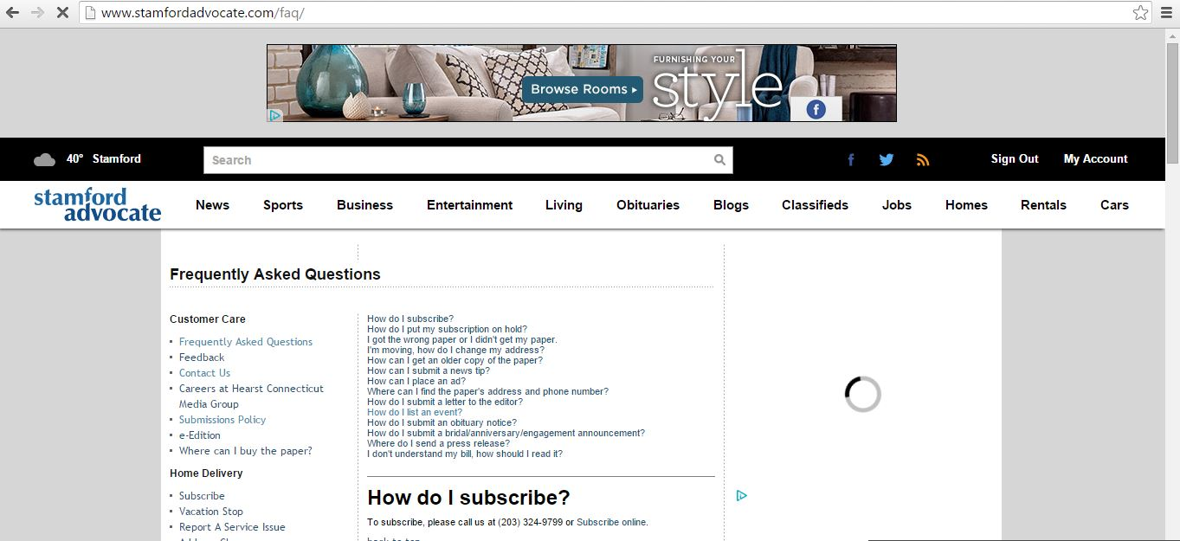
Stamford Advocate
Go to StamfordAdvocate.com
At bottom of webpage, select ‘FAQ’
Select ‘How Do I List an Event?’
Select ‘Click Here’

Slide 6
Stamford Advocate
Select ‘Add an Event’ and complete as directed
You will receive confirmation e-mails once your page is approved and posted
Note, to make a change or delete an event, you must e-mail inform spingo via link or e-mail. It is very difficult to edit a listing perhaps better to delete and start over, but once you submit, it is live!

Slide 7
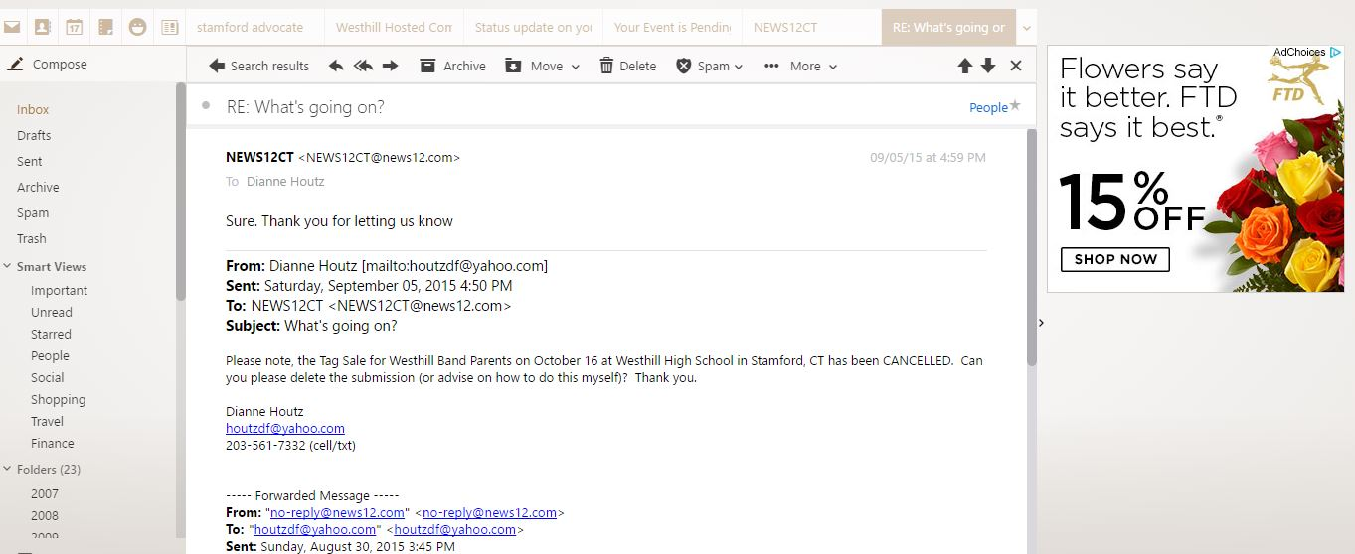
News12
Go to the News12CT website and at the middle of the page, look for the ‘What’s Going On section and select the ‘Submit’ button
You will be prompted to enter your event information in the site.
3. You will receive a confirmation of your event when it is posted. If you need to make a change write to: NEWS12CT@news12.com

Slide 8
Westhill Webpage
Send info, flyers, etc. to Sean Otterspoon. Very fast response.

Slide 9
Westhill E-mail Blast

Slide 10
Mayor’s Office
mayorsoffice@stamfordct.gov (you should use this first) however, if you have already been in contact,
Valerie Pankosky will reply: VPankosky@StamfordCT.gov

Slide 11
It’s Relevant
It’s Relevant would always showcase band camp and both the percussion shows for years, however, their format has changed. However, if the situation arises, you can contact:
ed@itsrelevant.net (editor)

